Slide 1
APOLOGETICS
IN ONE LESSON
almost
Ai1L.net
Lesson 24
Jesus Died by Crucifixion; His Disciples Believed He Resurrected

Slide 2
Key Takeaways (review)
1
Prophecy fulfillments come in a variety of forms
2
Don’t give up quickly, some of the fulfillments require lots of context; expect open questions
3
Some fulfillments make a better case for defending the Gospel than others

Slide 3
Four facts support Jesus’ resurrection
1
Jesus was crucified
2
Jesus’ disciples believed he resurrected
3
Early skeptics (Paul, James) became believers
4
The tomb was empty

Slide 4
IDEA IN BRIEF
What?
Understand the particulars of how the Gospel authors understood Jesus to have fulfilled prophecies
Why?
So that we are not swayed by arguments that assume the prophecies are taken out of context
How?
By showing that the fulfillments are not all simple 1-to-1 prophecies are sometimes require knowing more context

Slide 5
Read the non-Christian accounts of Jesus’ death by crucifixion
1

Slide 6
“...one is obliged to say, 'Here was a man. This part of the tale could not have been invented.'”
H.G. WELLS The Outline of History, Volume 1 (page 497)

Slide 7
Read the Gospels accounts of Jesus’ death by crucifixion
2

Slide 8
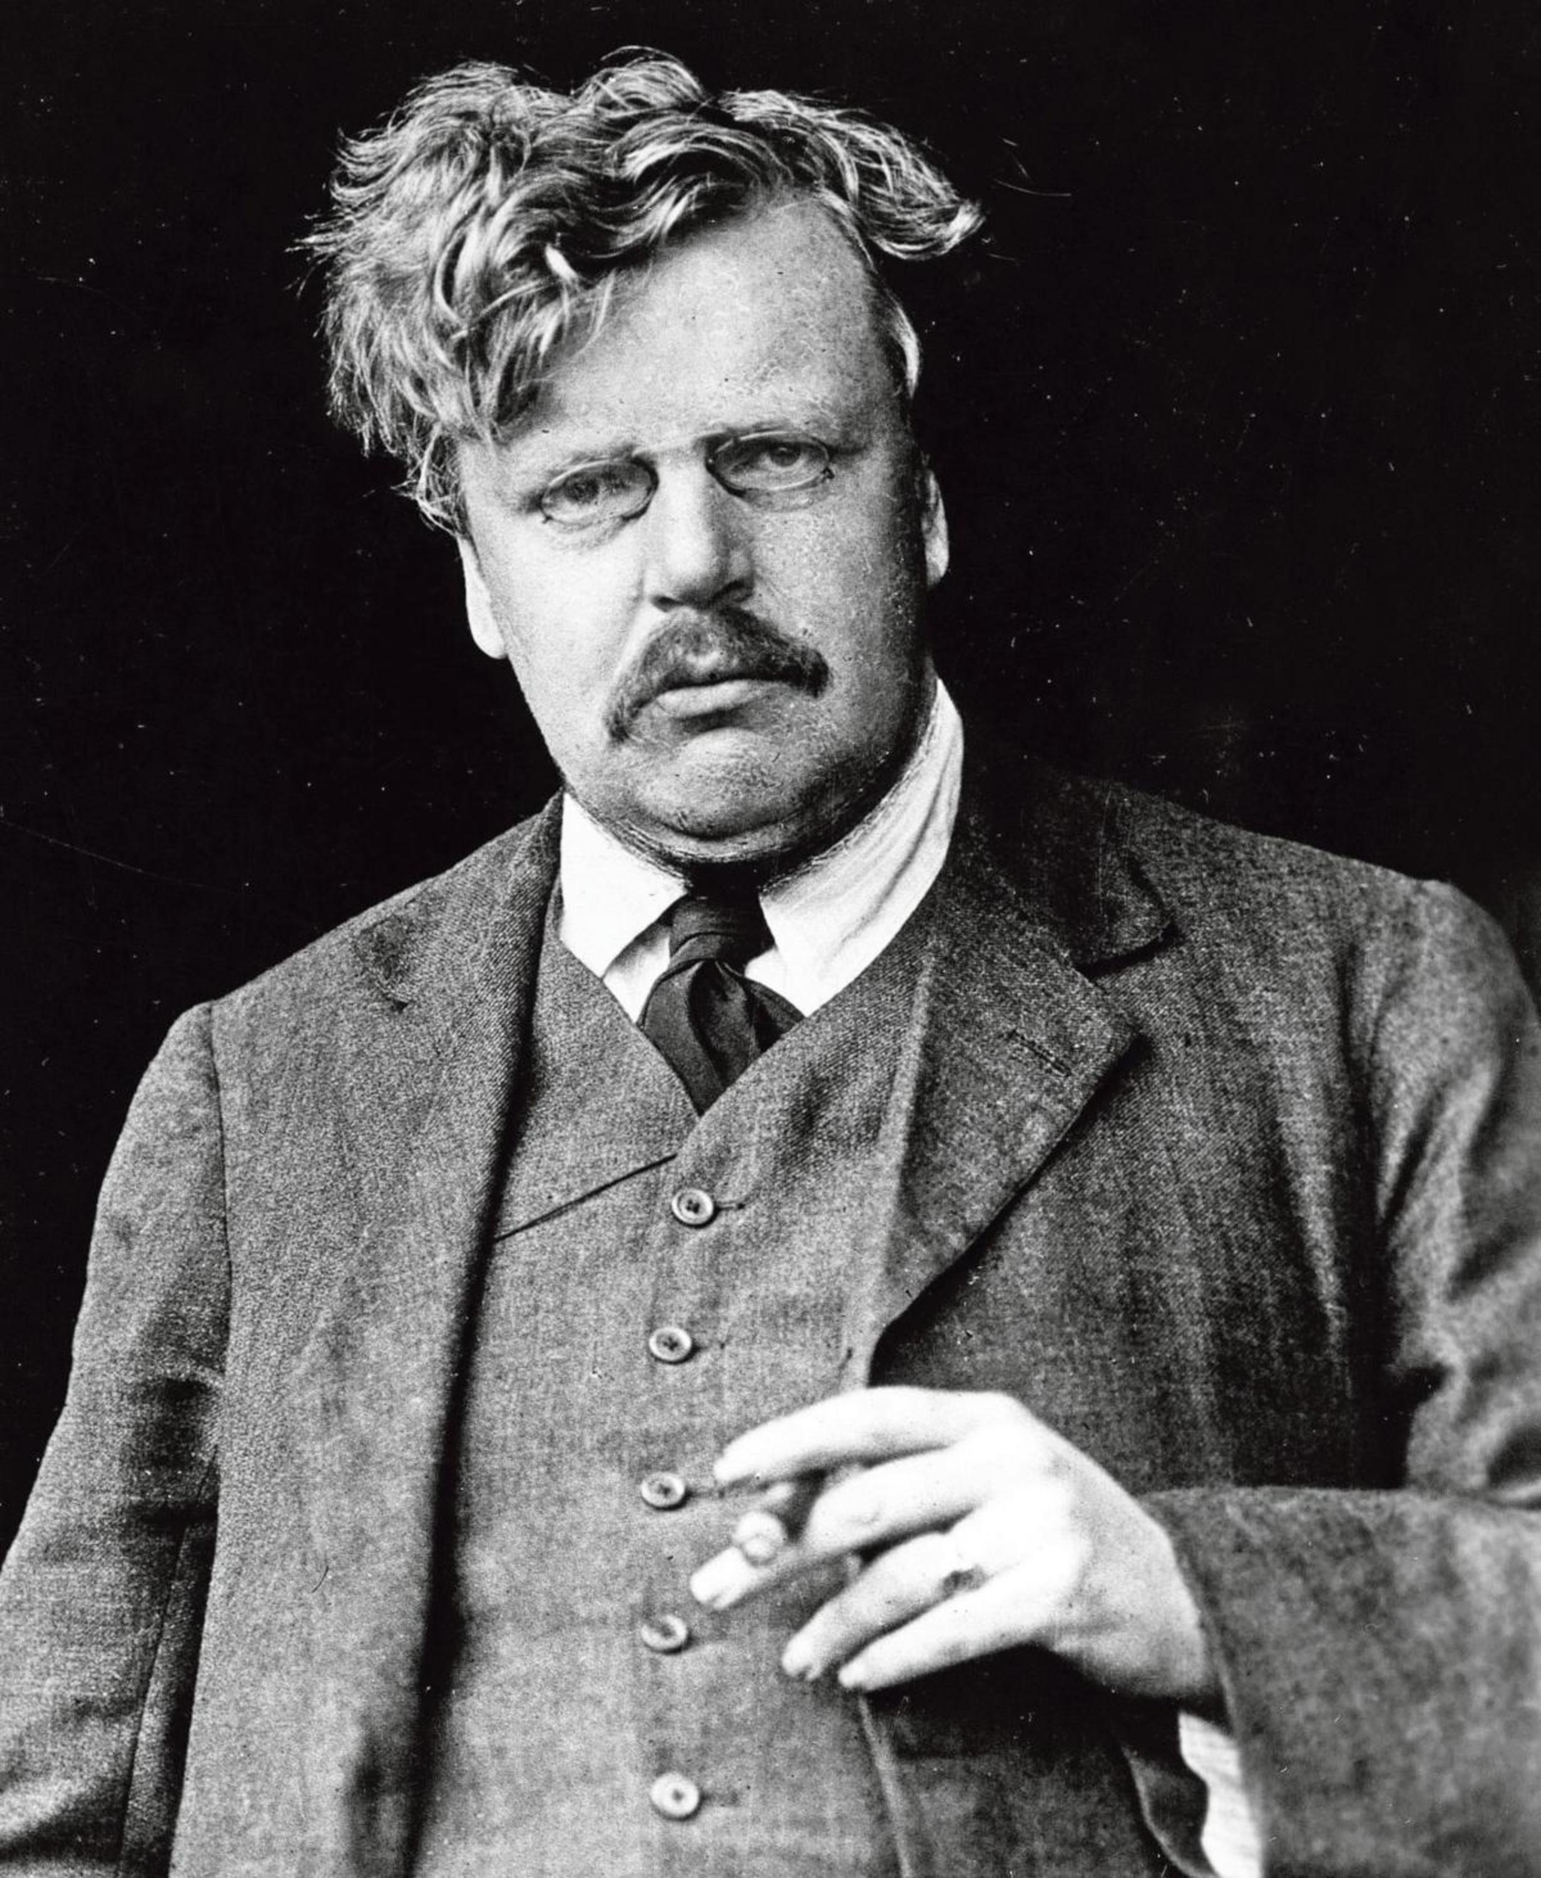
“This is the sort of truth that is hard to explain because it is a fact; but it is a fact to which we can call witnesses”
G.K. CHESTERTON The Everlasting Man

Slide 9
Document the claims of the early witnesses of Jesus’ resurrection
3

Slide 10
Which Apostles were martyred?
Peter
Paul
James, the Brother of Jesus
John, son of Zebedee
Thomas
Andrew
James, son of Zebedee
Philip
Bartholomew
Matthew
James, son of Alphaeus
Thaddeus
Simon the Zealot
Matthias
Source: “The Fate of the Apostles” by Josh McDowell
To be considered martyred, the person be killed due to being a Christian
This list includes those that are not specifically part of the Twelve (like James)

Slide 11
Which Apostles were martyred?
Peter
Paul
James, the Brother of Jesus
John, son of Zebedee
Thomas
Andrew
James, son of Zebedee
Philip
Bartholomew
Matthew
James, son of Alphaeus
Thaddeus
Simon the Zealot
Matthias
Source: “The Fate of the Apostles” by Josh McDowell
To be considered martyred, the person be killed due to being a Christian
This list includes those that are not specifically part of the Twelve (like James)

Slide 12
 | Peter
Death | Likely by crucifixion, probably by Nero
Confidence | Highest possible confidence
Sources | John 21:18–19 1 Clement 5:4–5 Ignatius Tertullian | Dionysius of Corinth The Apocryphon of James* Ascension of Isaiah* The Acts of Peter* Apocalypse of Peter*
 | No competing traditions
Other Details | Likely visited Rome Possibly crucified upside down
﻿* pseudepigraphal (authorship falsely attributed)

Slide 13
“Jesus said this to indicate the kind of death by which Peter would glorify God. Then he said to him, ’Follow me!’”
John 21:19

Slide 14
 | John (son of Zebedee)
Death | Not likely by martyrdom
Confidence | Improbably by martyrdom
Sources | John 21:18–19 Origen Tertullian
Other Details | Likely ministered in Ephesus
﻿* probably pseudepigraphal (authorship falsely attributed)

Slide 15
 | Thomas
Death | Executed in India by King Misdaeus
Confidence | More probable than not
Sources | Early church fathers St. Thomas Christians traditions The Acts of Thomas*
 | No competing traditions
Other Details | Traveled to India (more probable than not)
﻿* apocryphal (doubtful authenticity)

Slide 16
 | Andrew
Death | Crucified in 65-69 AD
Confidence | More plausible than not
Sources | Peter Chrysologus The Acts of Andrew* | Traditions in the East and West
 | No competing traditions
Other Details | Traveled to Greece (more probable than not)
﻿* apocrypha (not part of the New Testament)

Slide 17
 | James (son of Zebedee)
Death | Killed by Herod Agrippa I in Jerusalem
Confidence | Highest possible confidence
Sources | Acts 12:1-2 Papias Clement of Alexandria | Chrysostom Gregory of Nyssa Philip of Side
 | No competing traditions

Slide 18
 | Paul
Death | Beheading by Nero, AD 62-68
Confidence | Highest possible confidence
Sources | 2 Tim 4:6-8 Acts 19:21-28:31 1 Clement Ignatius | Dionysius of Corinth Irenaeus Tertullian
 | No competing traditions
Other Details | Highly likely to have visited Rome

Slide 19
 | James (brother of Jesus)
Death | Stoning, 62 AD
Confidence | Very probably true
Sources | Josephus Hegesippus | Clement of Alexandria First Apocalypse of James* Second Apocalypse of James*
 | No competing traditions
Other Details | Thrown from the Temple
﻿* pseudepigraphal (authorship falsely attributed)

Slide 20
“﻿not a shred of evidence exists that any apostle wavered in or recanted his faith—excluding Judas.”
SEAN MCDOWELL The Fate of the Apostles (page 261)

Slide 21
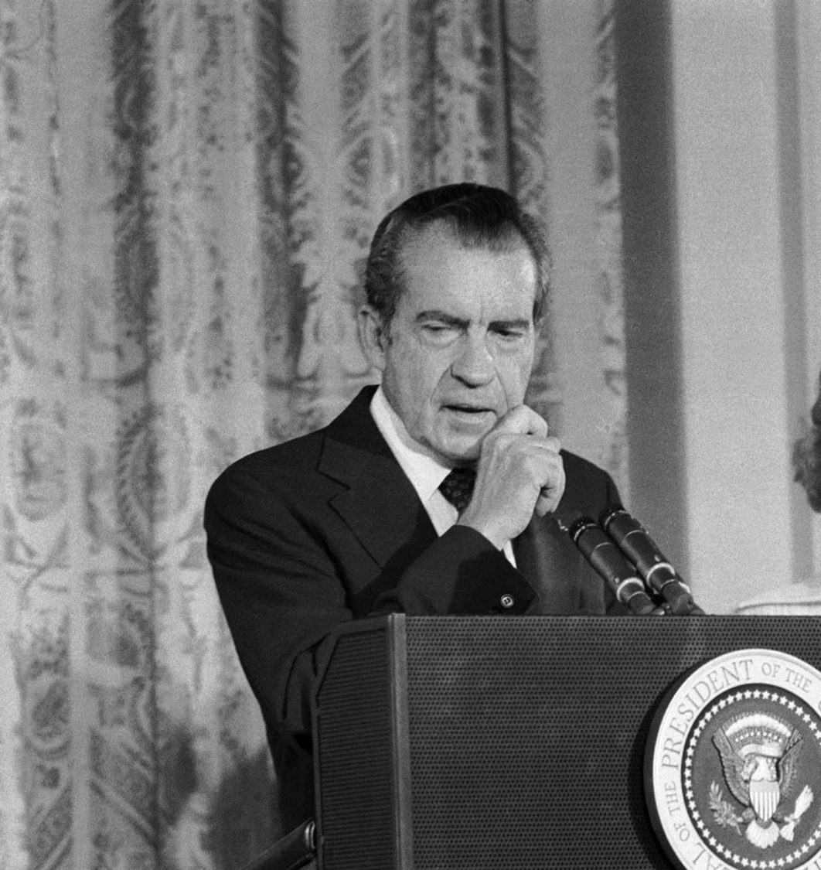
“The real cover-up, the lie, could only be held together for two weeks”
CHUCK COLSON (former Nixon Aide) Breakpoint with Chuck Colson, 2002/03/29

Slide 22
Key Takeaways
1
Jesus’ crucifixion is supported by many historical accounts
2
Jesus’ disciples were willing to die as eyewitnesses
3
The willingness to die is important when the sources are eyewitnesses

